Slide 1

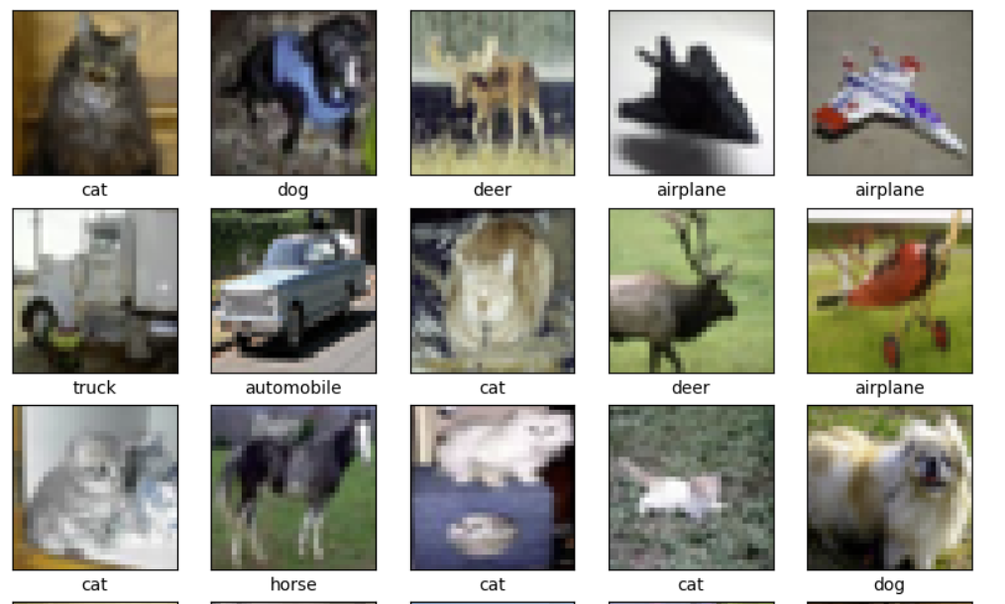

CSC485B Machine Learning for Robotics
SUNY Plattsburgh
Dr. Ned Lecky
Class 24: Deep Computer Vision Continued

Slide 2
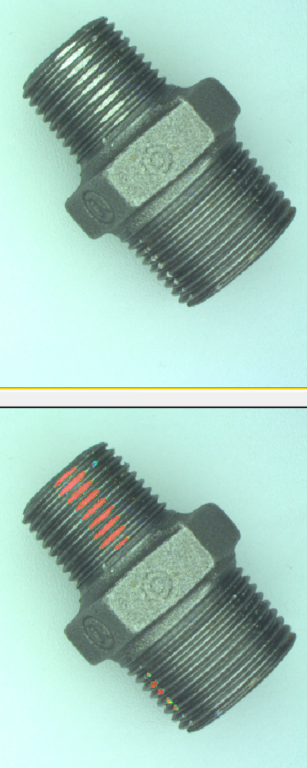
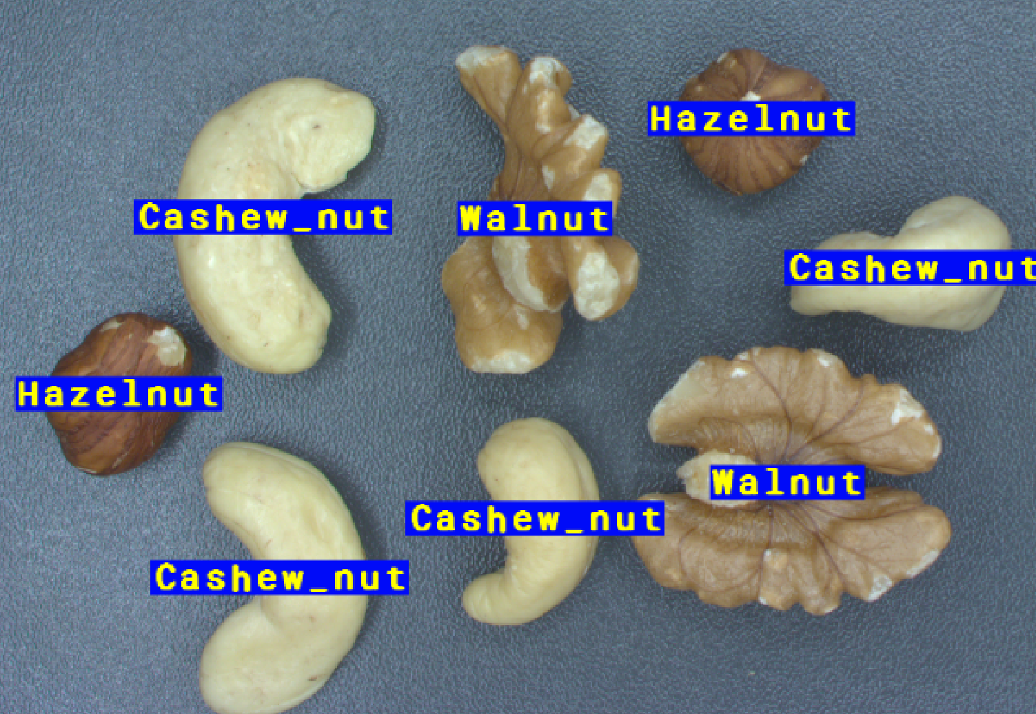
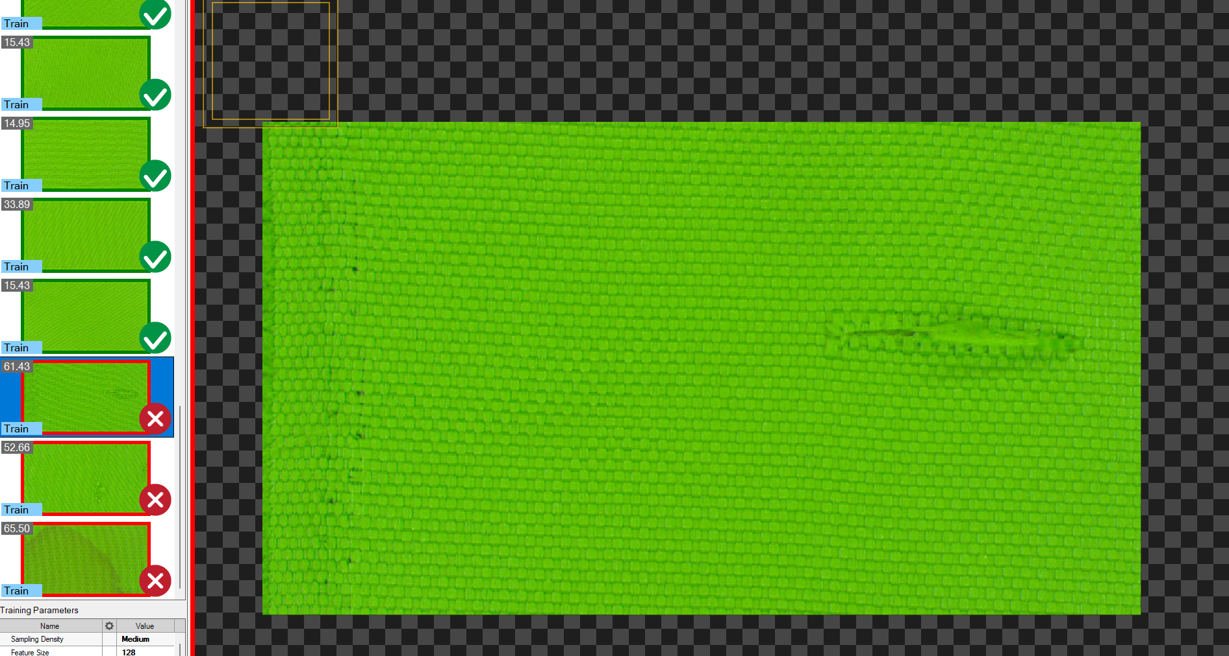
More Experiments with AuroraVision
Nut Segmentation
Training Dataset and Labeling
Detect Anomalies
Textile Inspection
Thread Inspection
Defect detection
BUUUTTTTT
What if we wanted to do it ourselves?

Slide 3
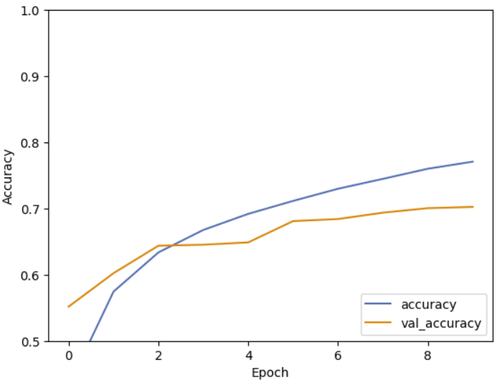
Doing This in Keras: CNN
Here is a great initial setup that RUNS!
So many don’t!
https://www.tensorflow.org/tutorials/images/cnn
This is a great starting point for your own experiments
Low res runs fast
How do you decide if you have enough resolution?
Hint: Can a HUMAN identify the animal??

Slide 4
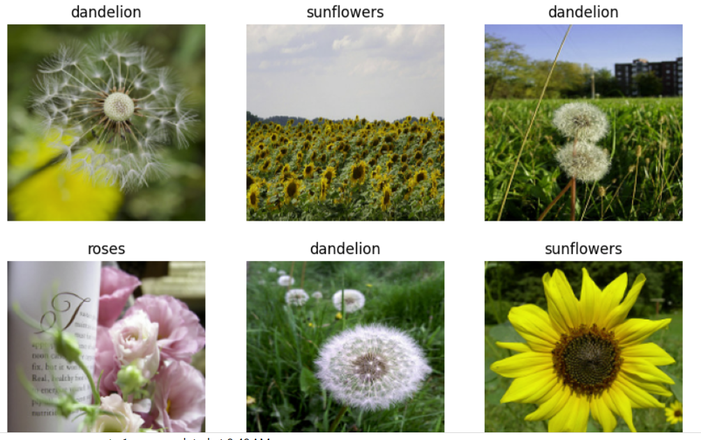
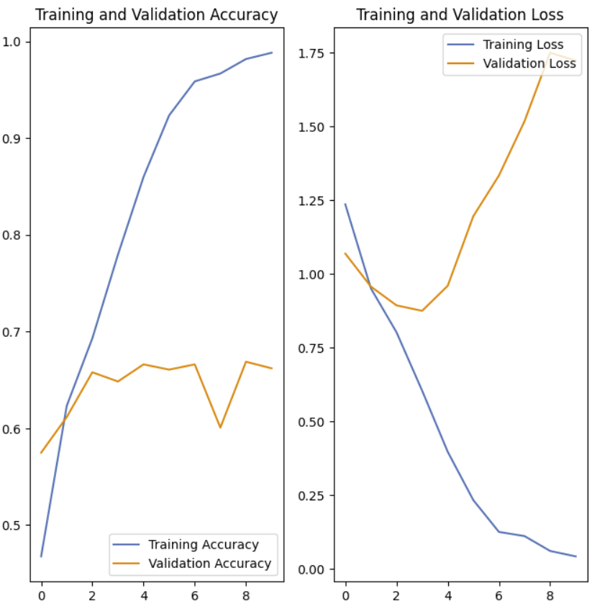
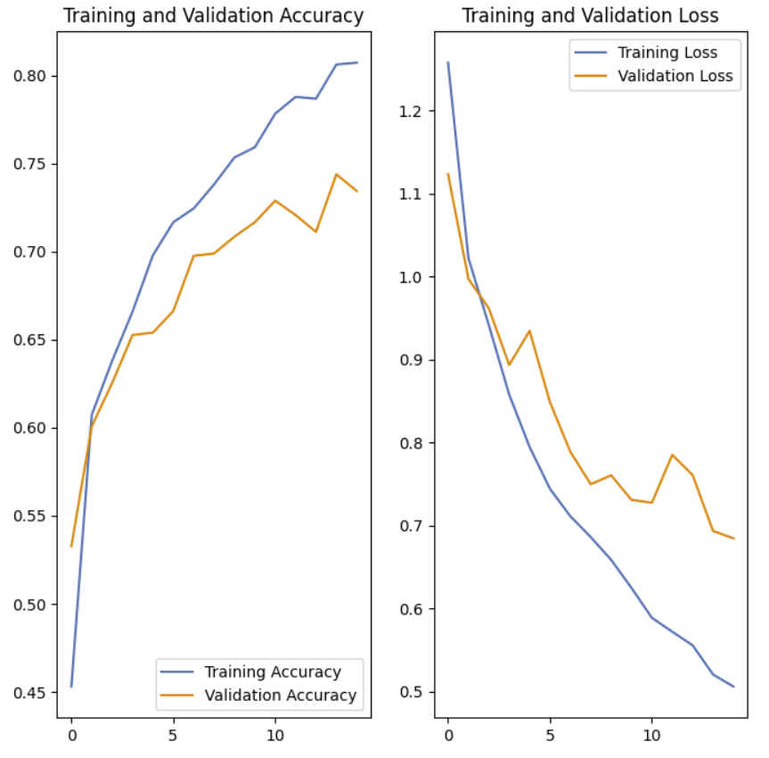
Keras Image Classification
This example is terrific, too!
https://www.tensorflow.org/tutorials/images/classification
Training on flower images
Works well on training data but OVERFITS
To improve
Data augmentation
Generate randomly flipped, rotated, scaled versions of the training data
Use dropout to keep neurons from getting muscle-bound

Slide 5
TensorFlow Lite
This example also shows how to take your trained model and run it on small devices
# Convert the model.
converter = tf.lite.TFLiteConverter.from_keras_model(model)
tflite_model = converter.convert()
# Save the model.
with open('model.tflite', 'wb') as f:
f.write(tflite_model)

